Slide 1

Instrumental - Mechatronik Complexes for On-line Flow Structure-Dynamic Analysis of Oils by Nuclear Magnetic Resonance Relaxometry Method
Paper Number
000
G. OVSEENKO (1), O. KOZELKOV (2), R. KASHAEV (3), T. TUNG (4),
N. CHI KIEN (5)
1-5 Kazan State Power Engineering University, Kazan, Republic of Tatarstan. Russian Federation

Slide 2
Goals.
Paper Nr
001
Urgent requirement of the oil-industry - is the possibility for express-analysis in laboratories and on-line flow of physical-chemical parameters (PCP):
of the oil disperse systems (ODS - crude and dry oils, oil products);
concentrations of water, sulphur, asphaltenes Asph, hydrocarbons, paraffin’s;
density ρ and viscosity η in oils;
water droplets distribution;
velocity of the crude oil flow (debit) in the pipeline after chink or bore-hole.
Characterization of oil systems using nuclear magnetic resonance (NMR) techniques is a vast and expanding scientific activity Lo. It is one of the key problems of petroleum reservoir engineering and NMR is the most perspective technology, capable to do such estimates Shikhof, Arns.

Slide 3
Problems / Method.
Paper Nr
002.
The unique feature of the NMR approach is the diversity of chemical and physical properties at different structural levels that can be accessed using a single NMR instrument.
Nuclear Magnetic Resonance Relaxometry (NMRR) is unique for molecular motions and viscosity studies. Such opportunities possess nuclear (proton) magnetic resonance relaxometry (NMRR) method:
Advantages, which need not sample preparation, nondestructive, can be used in explosive and fire dangerous zone, easy for automation and very fast – measurement time usually is less, then 2-3 minutes.
From all methods of water control NMRR is the sole, which embrace the whole range up to 100% of water and gas concentrations.
On-line NMR-control of crude oils and oil products components is not used until now, but we have constructed on-line NMR-control installation.

Slide 4
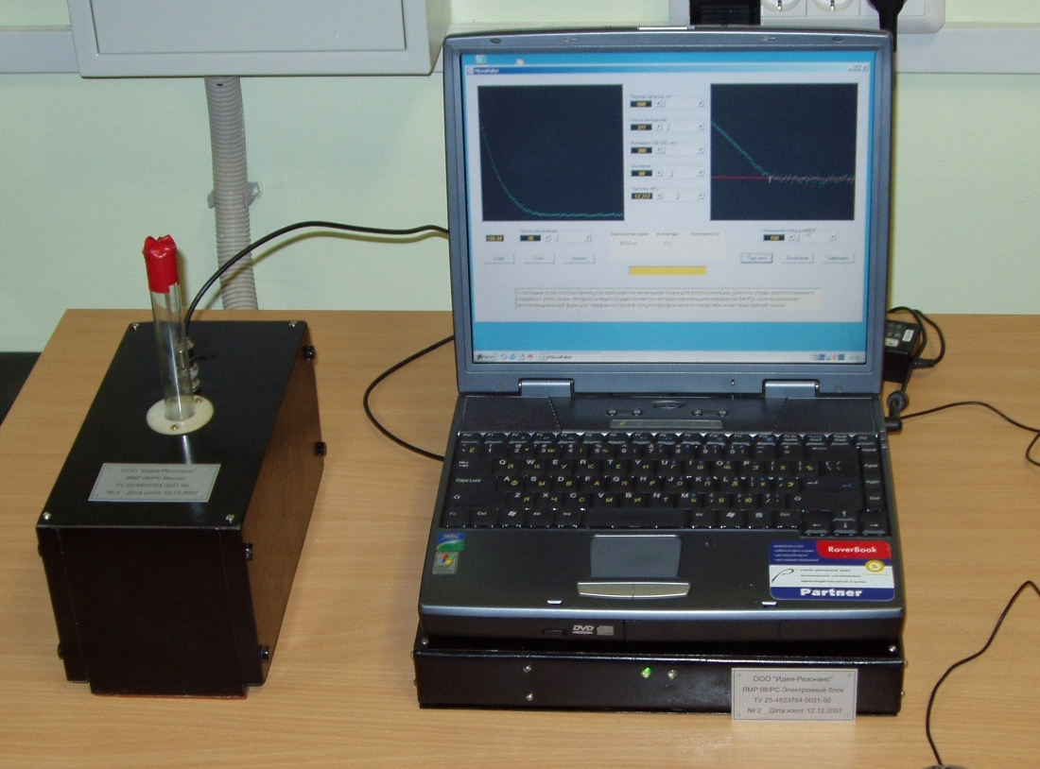
Development / Results.
Paper ID:
…..
Paper Nr
003
We have also designed new portable, easily transported relaxometers NMR NP-1 with parallel interface and NMR NP-2 (fig.1) with USB interface [Kashaev R.S., Temnikov A.N., Idiyatullin Z.Sh.
Fig.1. Portable Relaxometer NMR NP-2 with USB interface

Slide 5
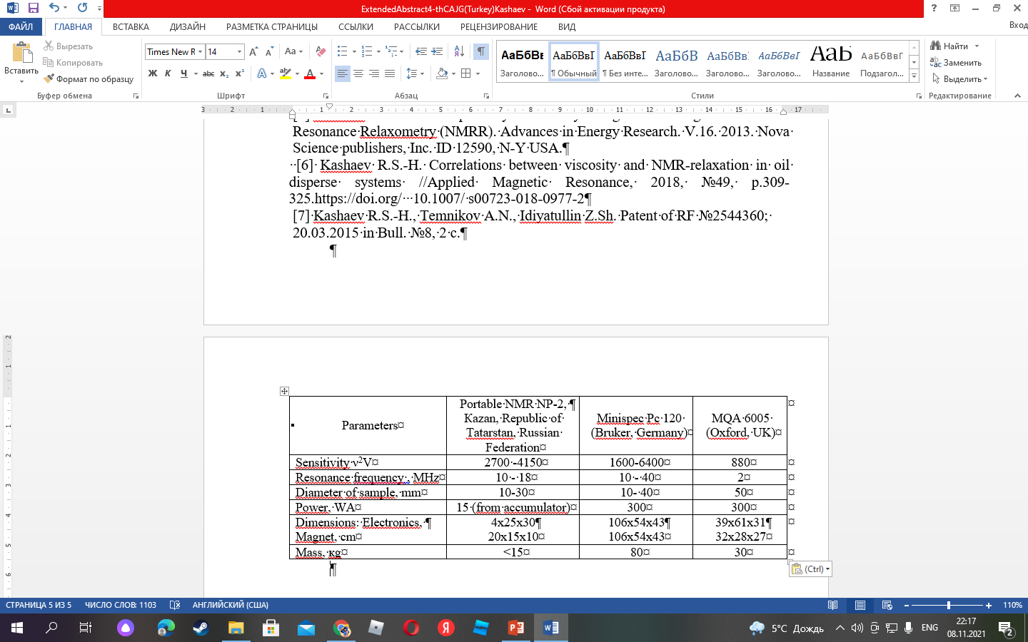
Paper Nr
004
Portable relaxometer of NMR. Patent of RF on useful model № 67719, 2006] with the weight less, then 15, connected with Notebook by USB-port. It is used for express-analysis of PCP. Time of measurement < 2 minutes. Sensibility is К = ν²D³ [МHz²см³] = 2700-4150 МHz²см³, that is near to “Minispec pc120” (Bruker,Germany). Magnetic system is build from rare earth elements alloys NdFeB. Heterogeneity of H₁ field is < 2% in 75% of volume.
Comparative parameters of portable NMR NP-2 with NMR-relaxometers Table 1

Slide 6
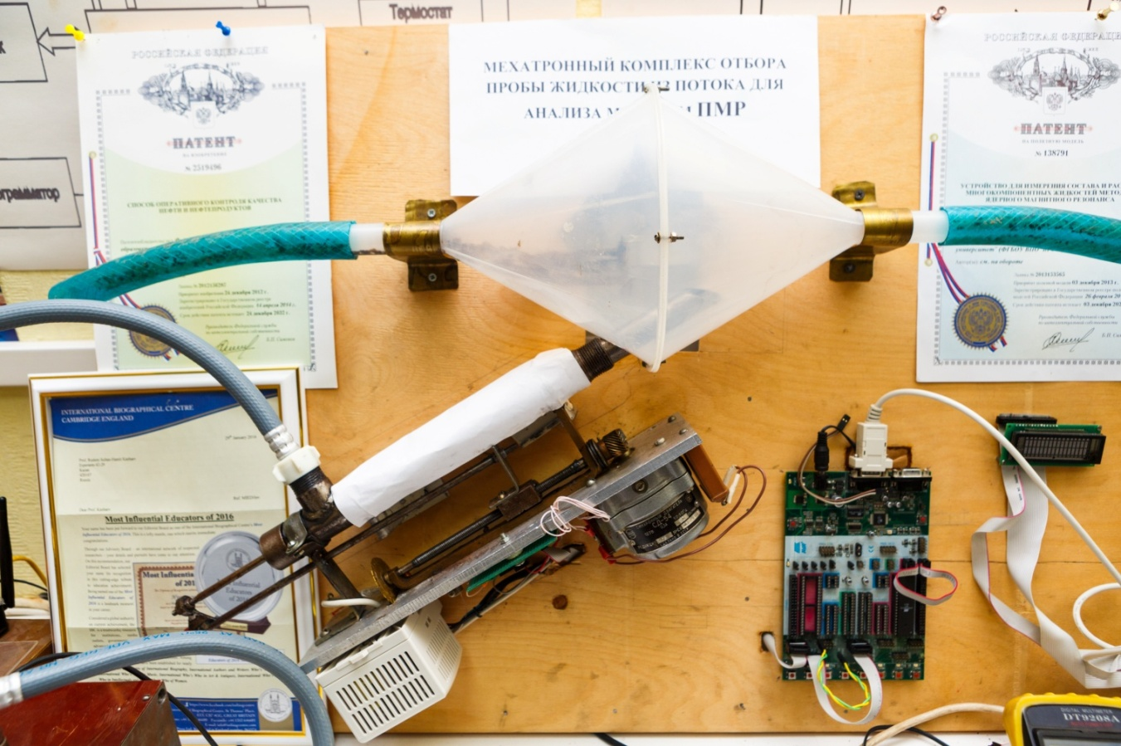
Development / Results.
Paper Nr
005
For on-line express-control of the oil-well liquid and crude oil properties we have elaborated mechatronic complex with incorporated system of representative liquid probe sampling with program of automatic operation from microcontroller ATMEGA8515L and NMR-analizer, presented at fig.2.
Fig.2. Mechatronic complex with incorporated system of representative probe sampling with automatic operation from microcontroller ATMEGA8515L.

Slide 7
Thank you!
Paper Number
006
Galina Ovseenko=> galinka.ovseenko@mail.ru

